Slide 1
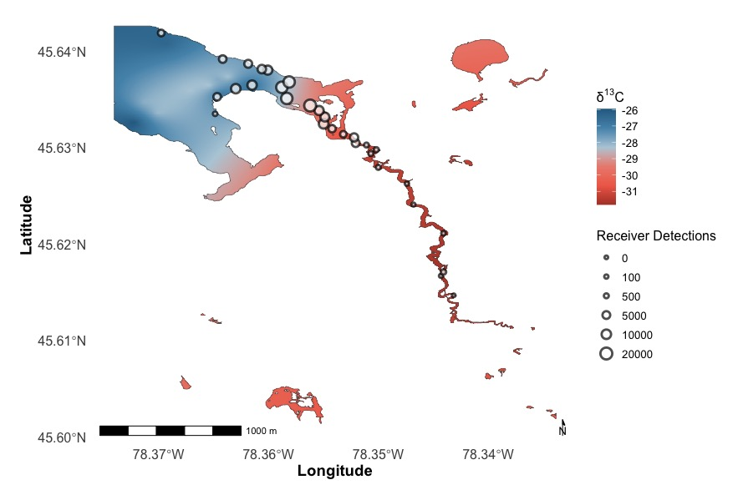
Carbon Signature
Receiver Detections

Slide 2
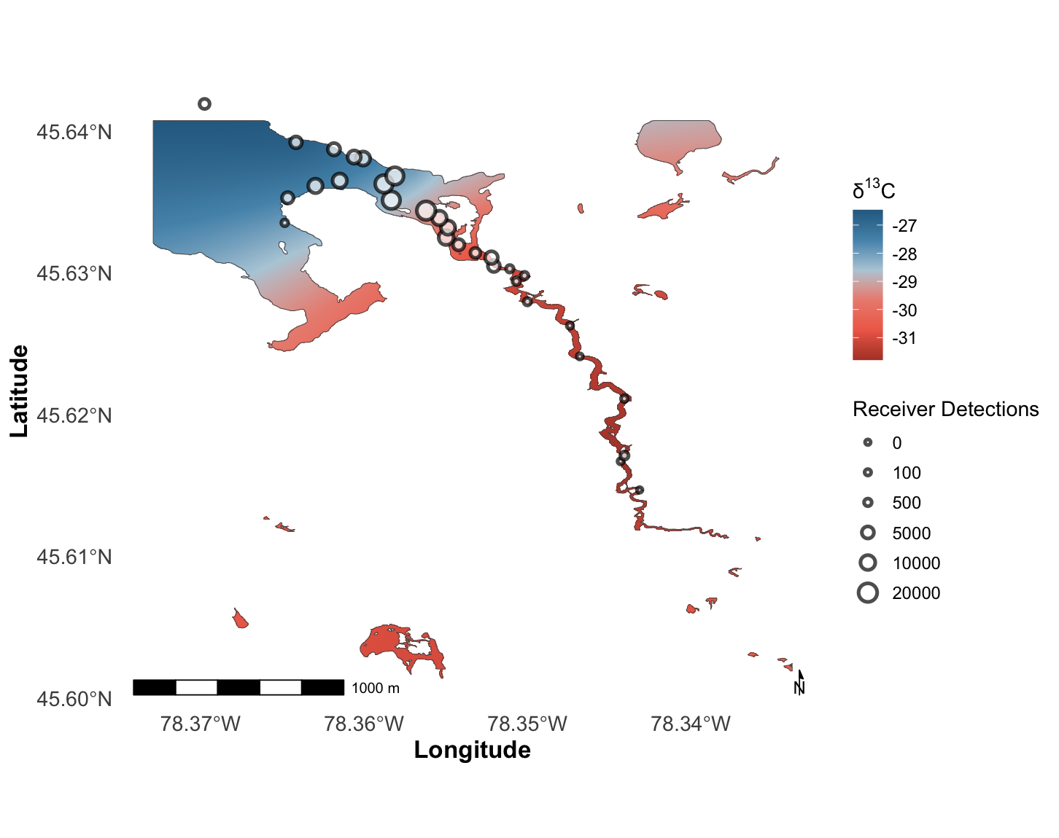
Carbon Signature
Receiver Detections

Slide 3
Lake
Carbon Signature
Transition habitat
Stream
Receiver Detections

Slide 4
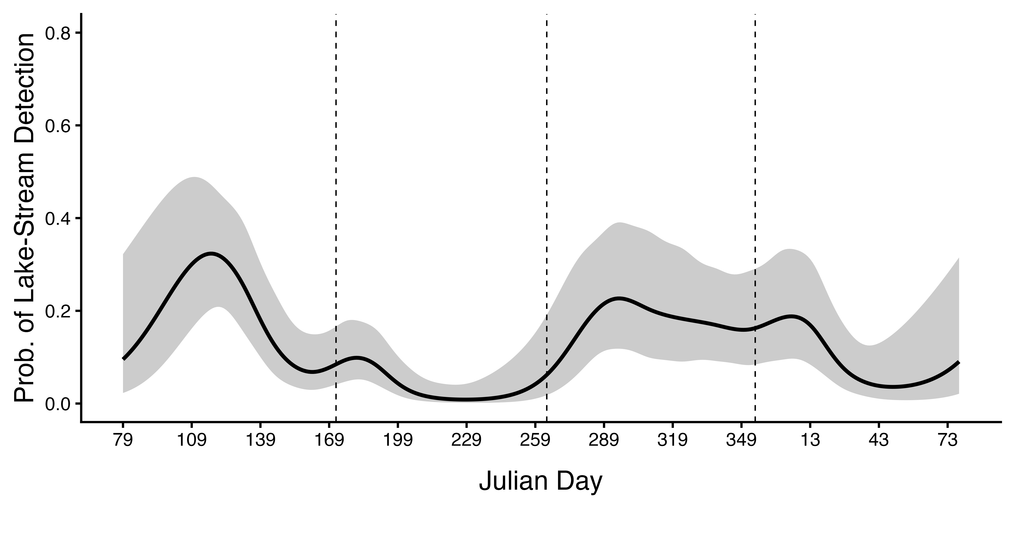
Spring
Summer
Fall
Winter

Slide 5
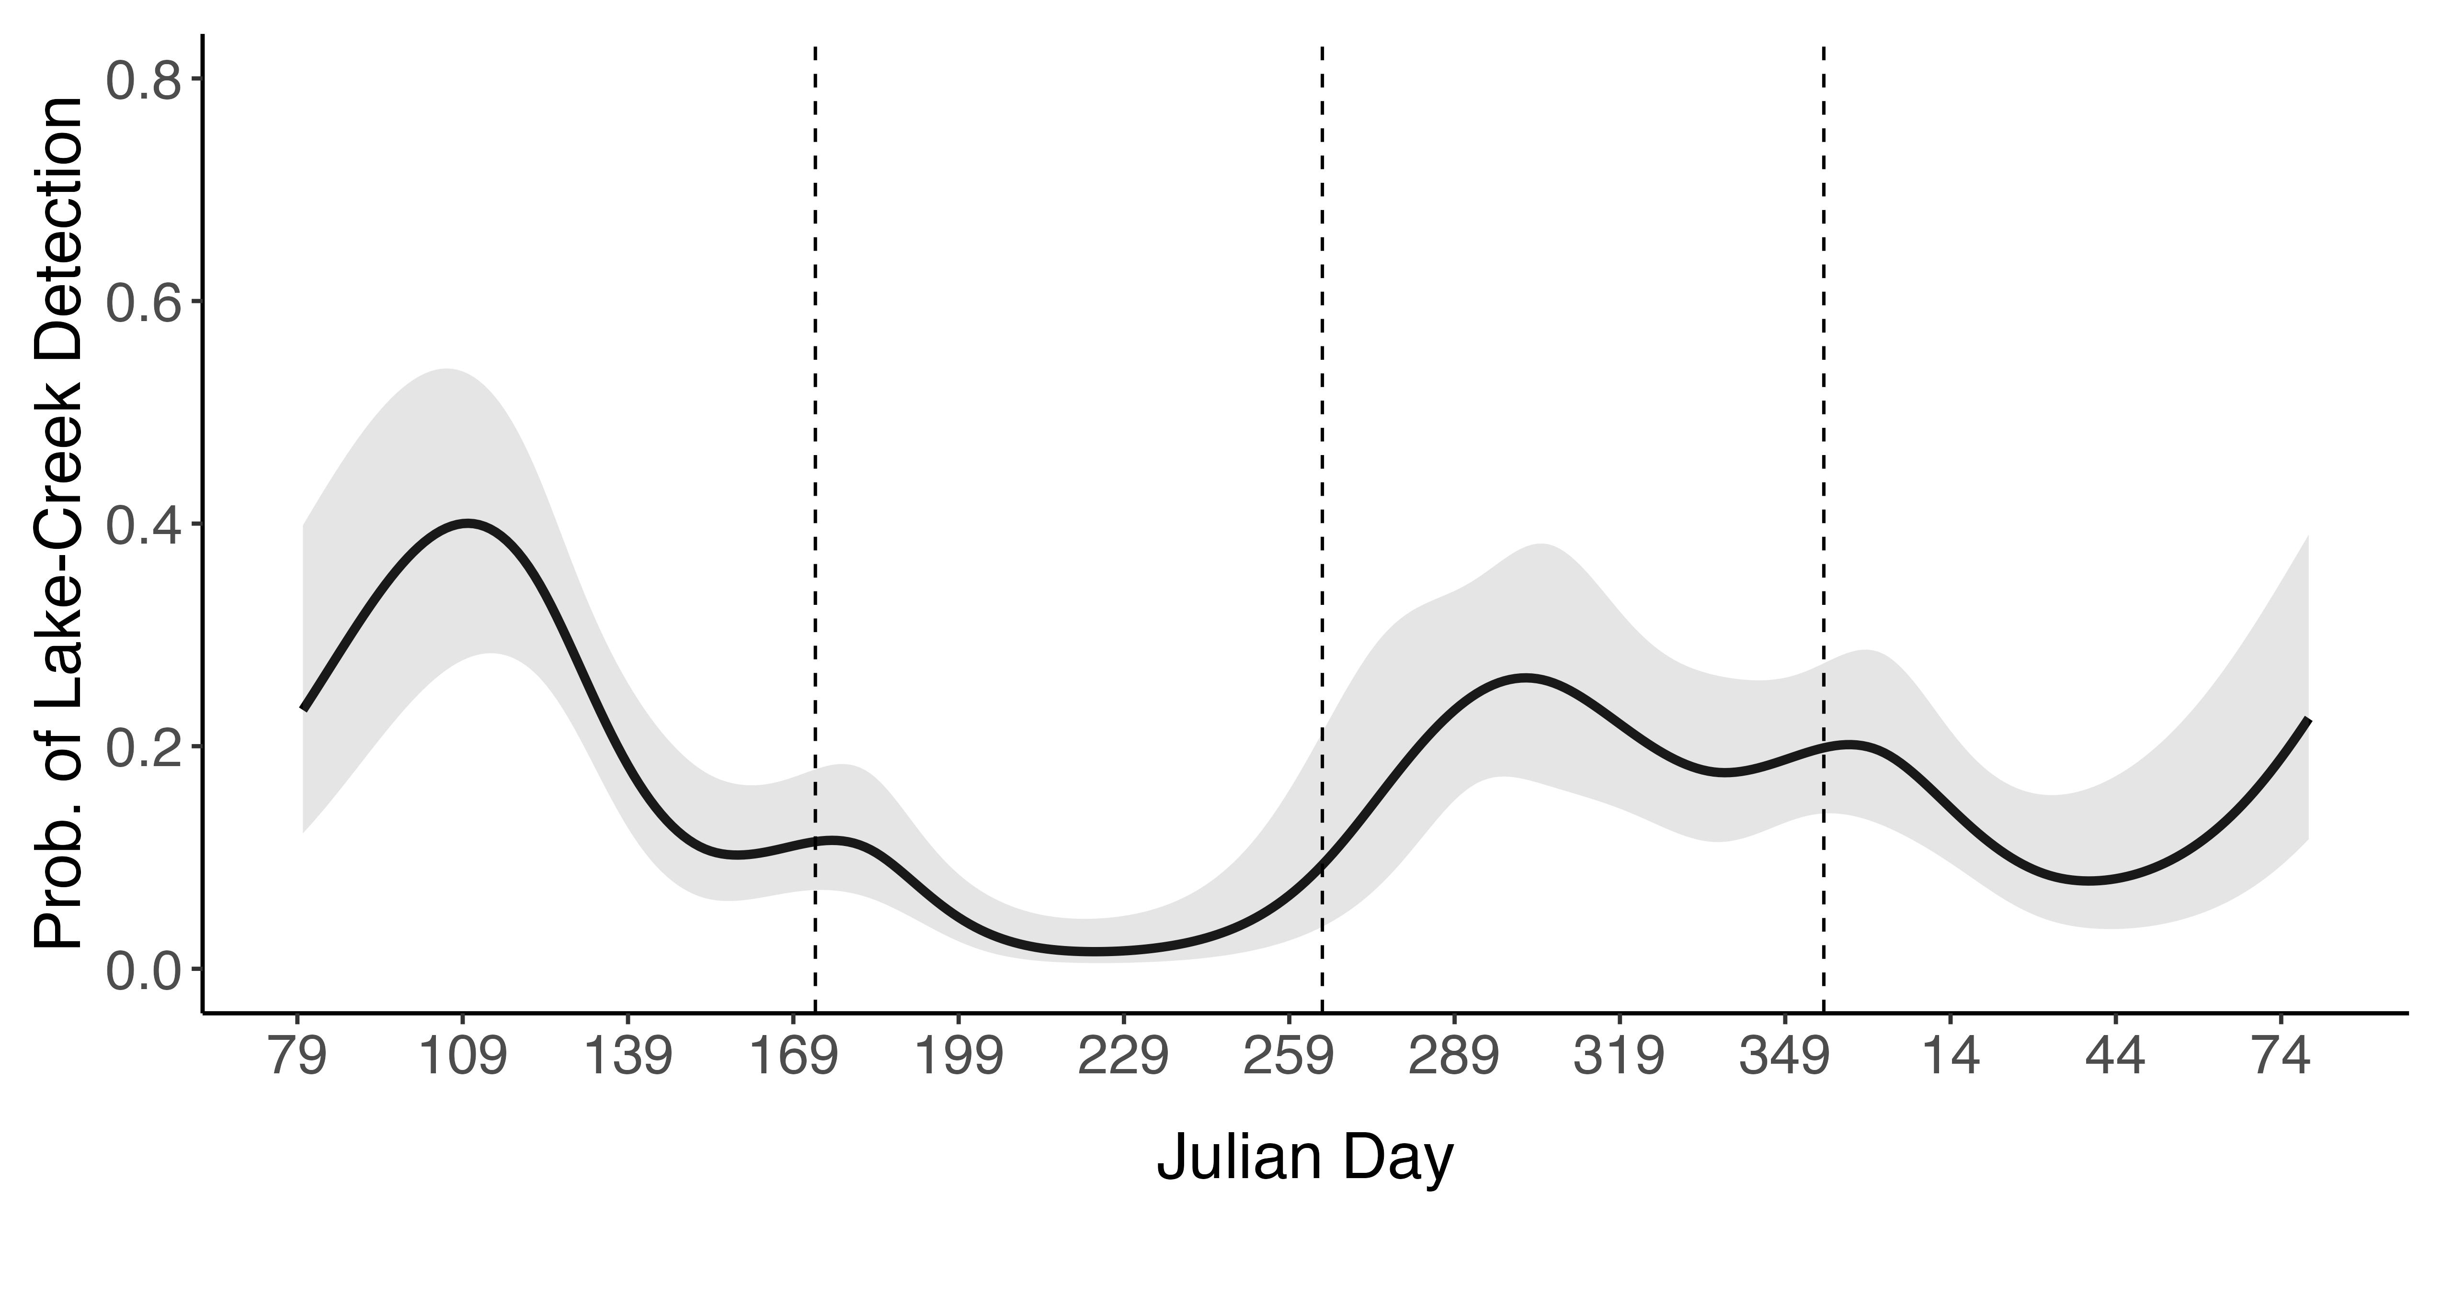
Spring
Summer
Fall
Winter

Slide 6
Foraging
Habitat Use
A
C
Habitat of capture
Stream
Lake
B
D

Slide 7
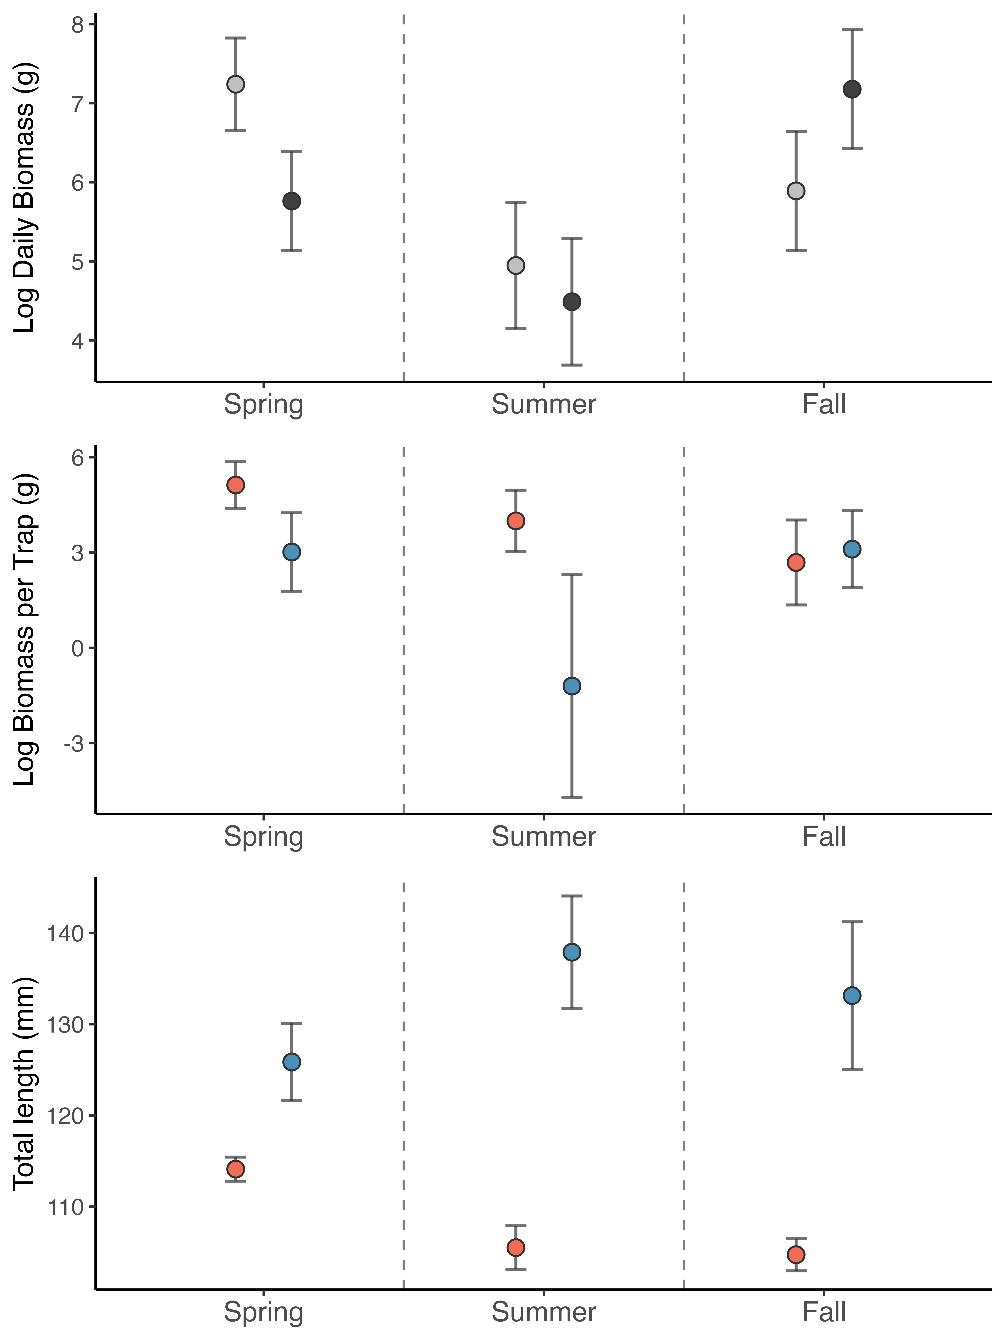
A
Direction of movement
Upstream
Downstream
B
Location of capture
Creek
Lake
C

Slide 8
A
Direction of movement
Upstream
Downstream
B
Location of capture
Stream
Lake

Slide 9
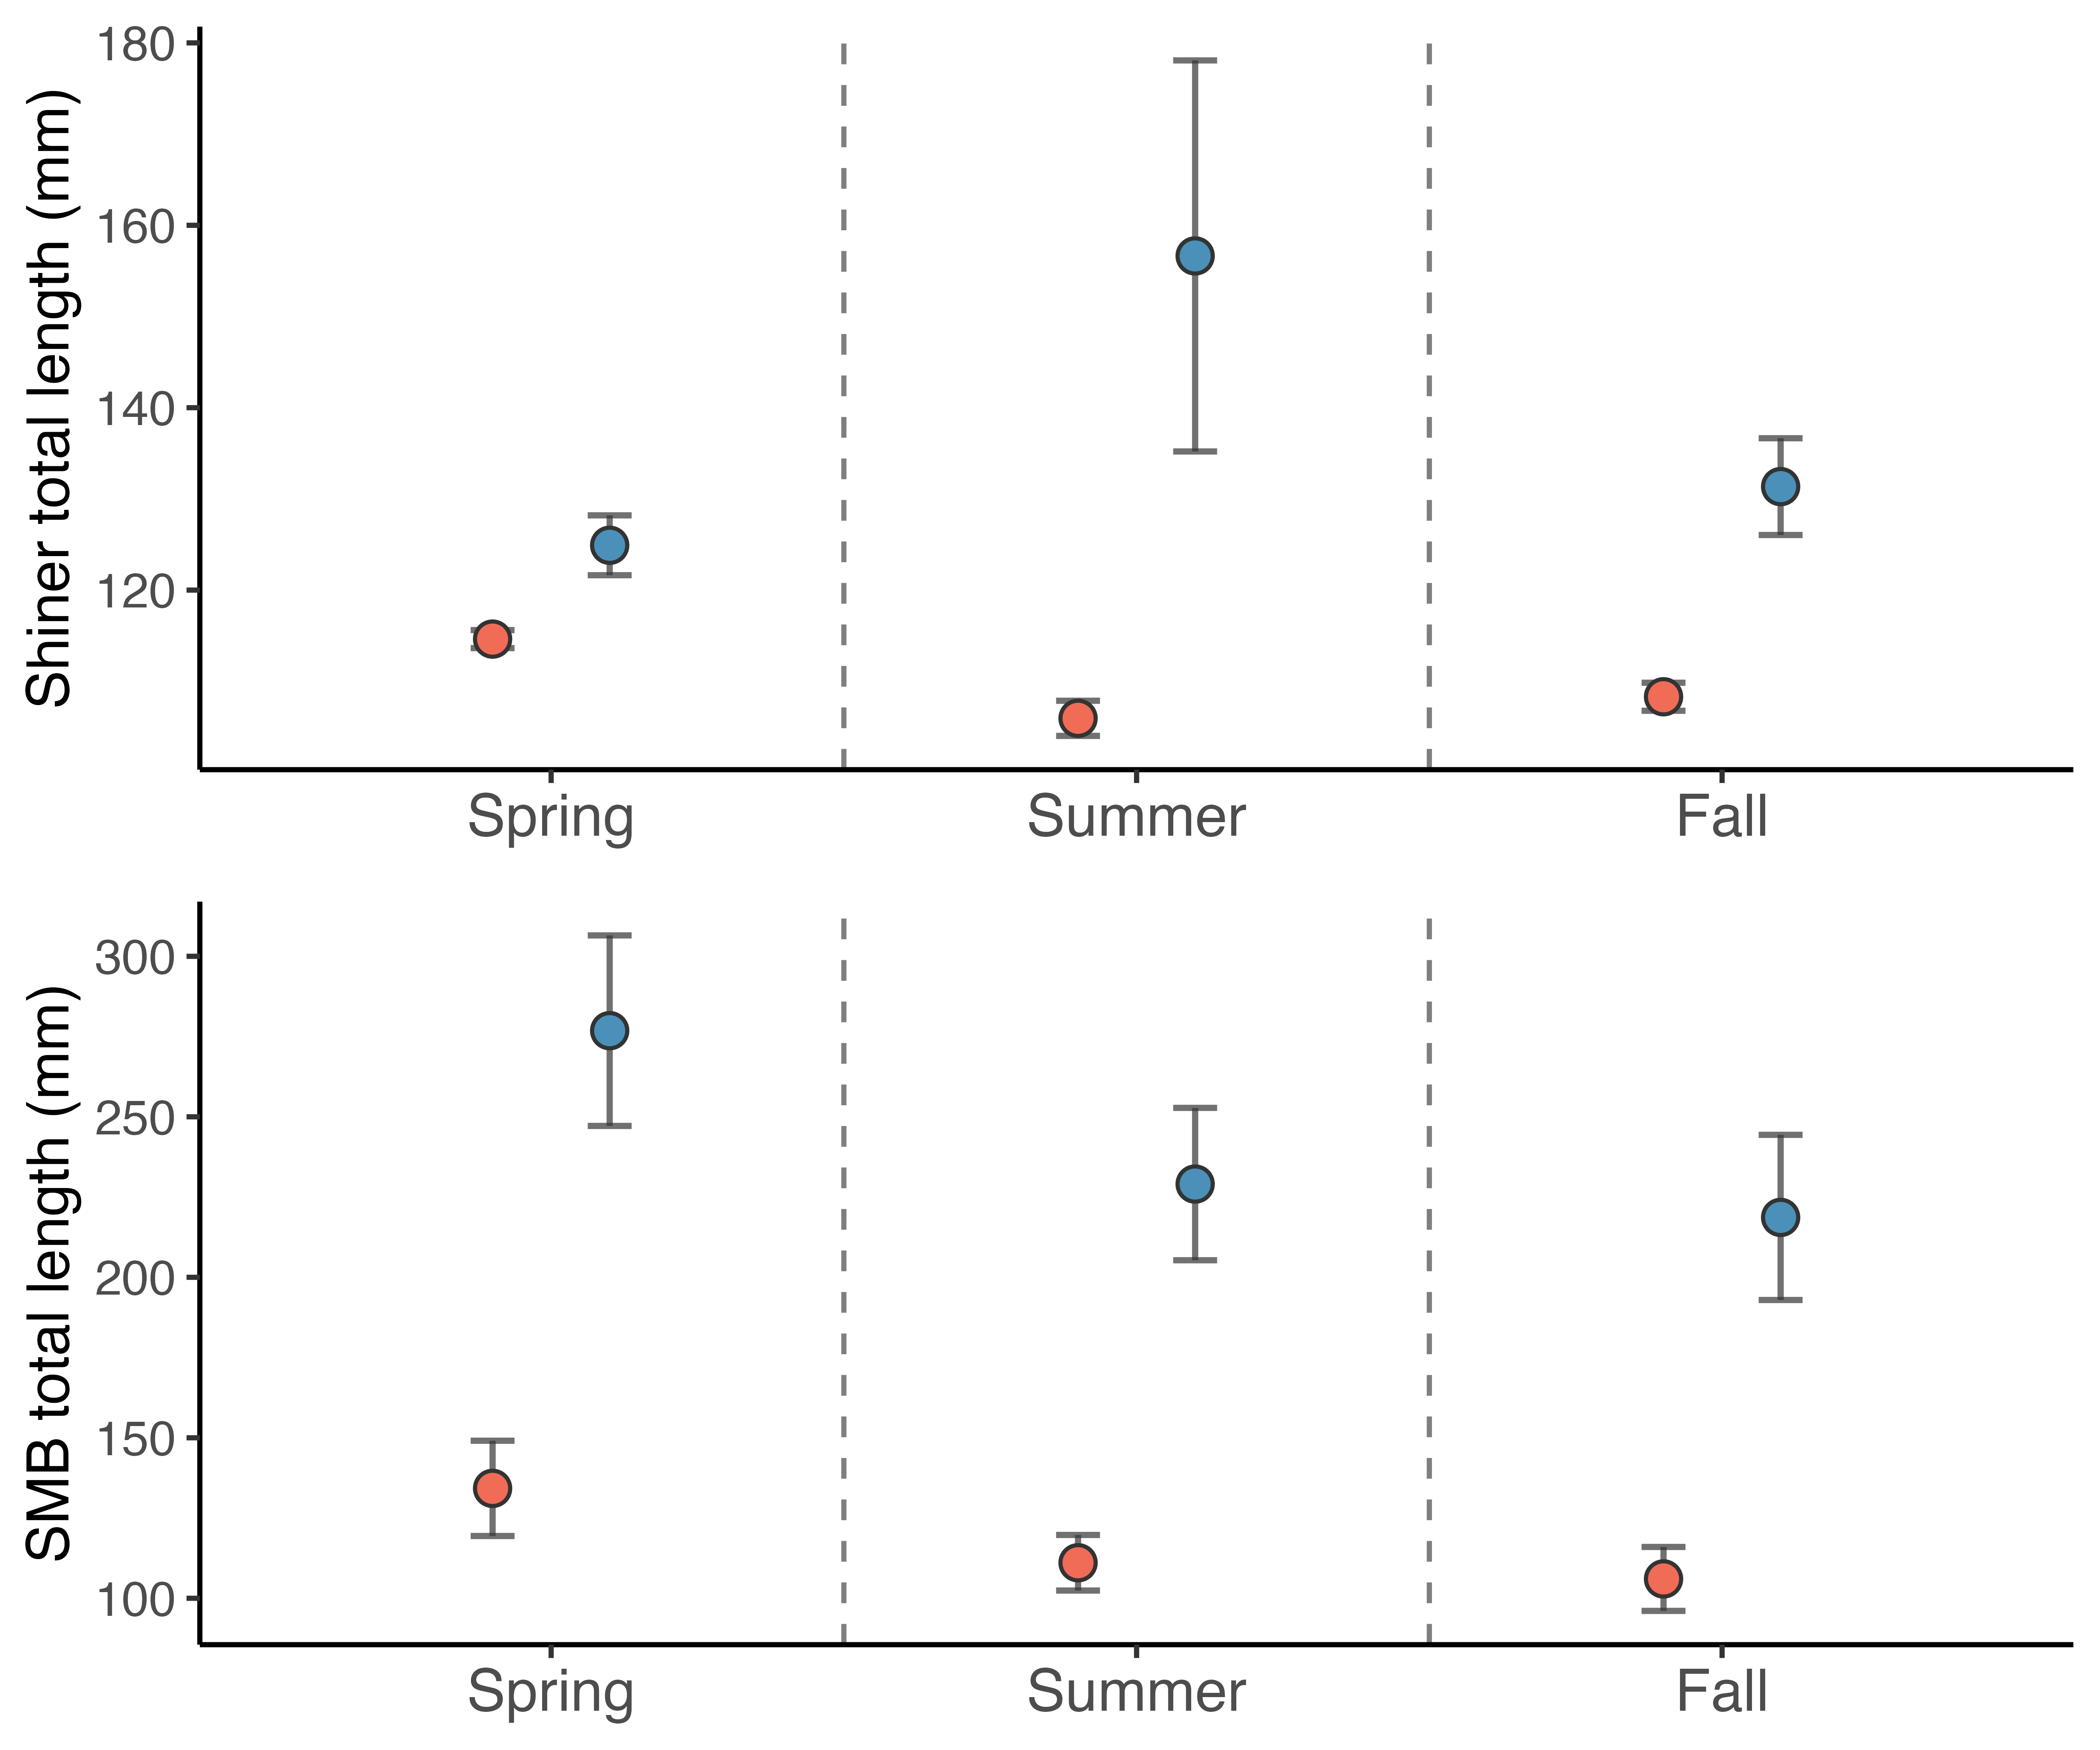
A
Location of capture
Stream
Lake
B

Slide 10
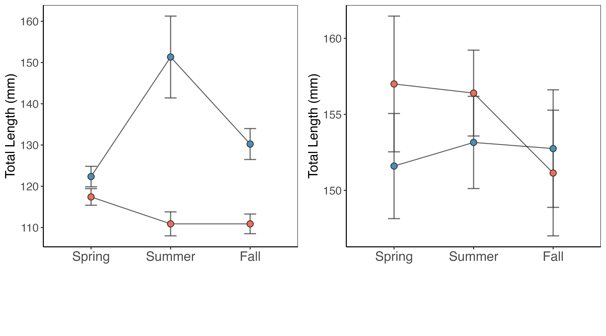
Foraging
Habitat Use
Location of capture
Creek
Lake

Slide 11
Foraging
Habitat Use
A
B
Location
Creek
Lake
C
D

Slide 12
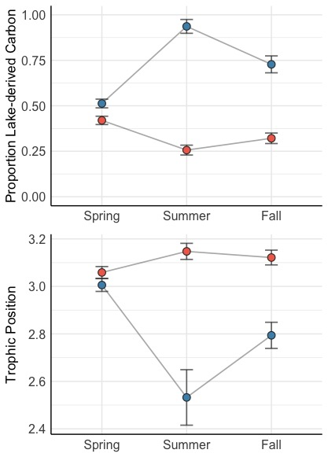
A
Location
Creek
Lake
B

Slide 13
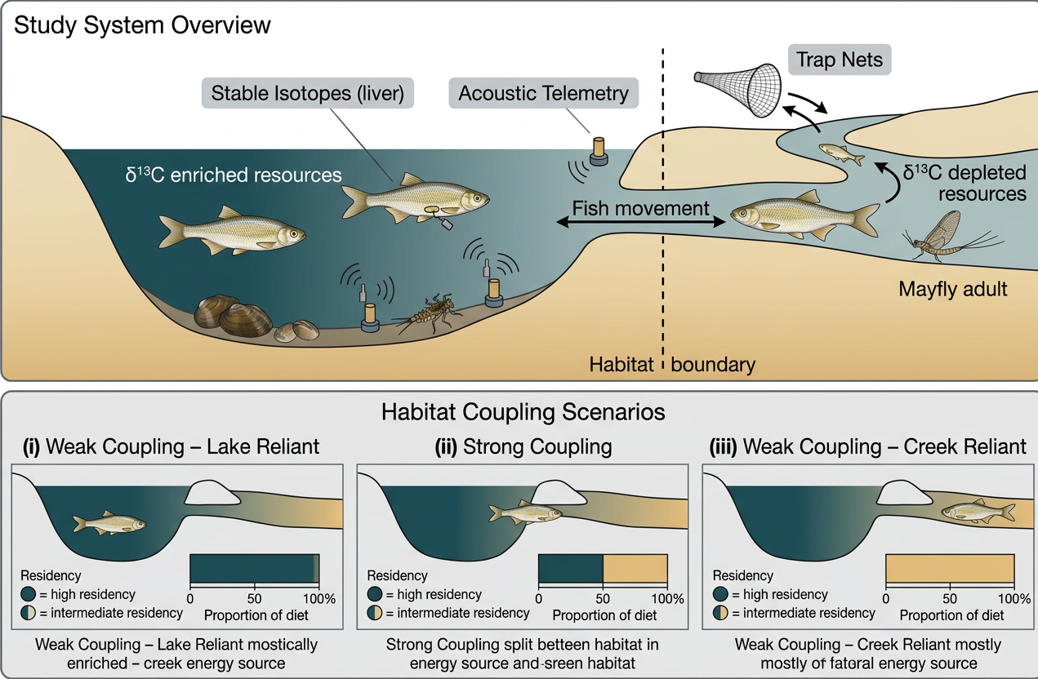

Slide 15
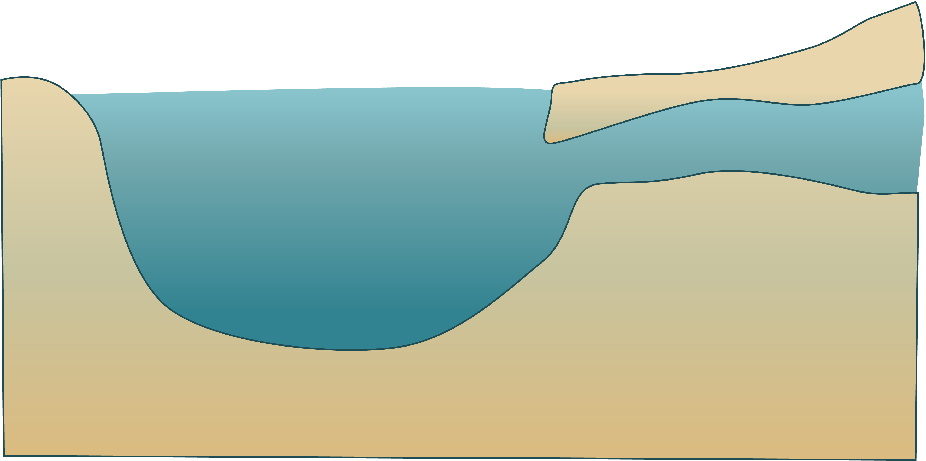

Slide 16
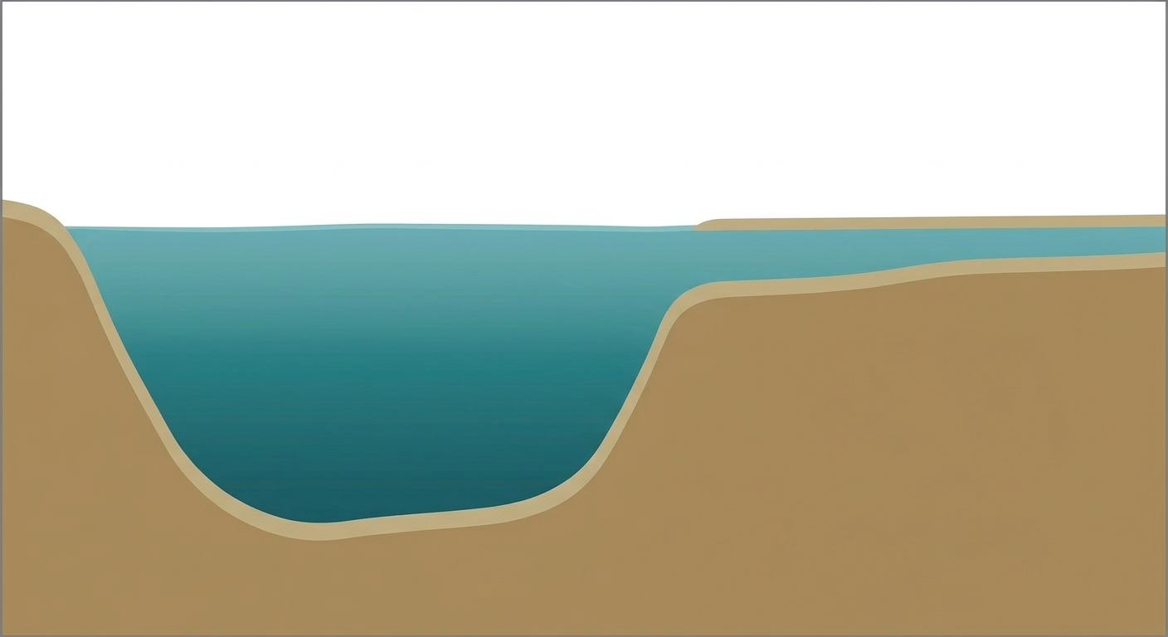
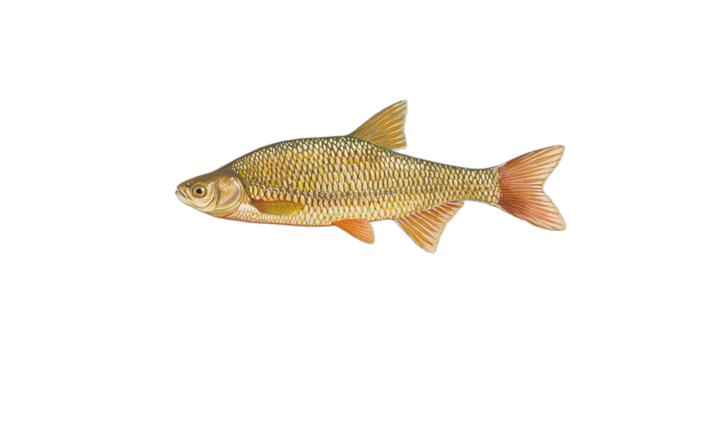
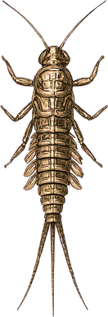


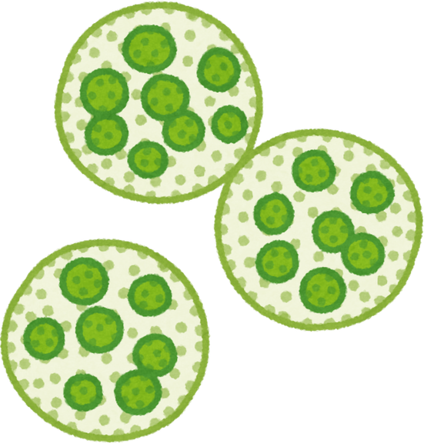
Directional Trap Nets
Stable Isotopes (Liver)
Stream
Tag
Tag
δ¹³C depleted resources
δ¹³C
Lake
Receiver
Acoustic Telemetry
δ¹³C enriched resources

Slide 18
Study System
Habitat Coupling Scenarios
(i) Lake Residency
(ii) Habitat Coupling
(iii) Creek Residency

Slide 19
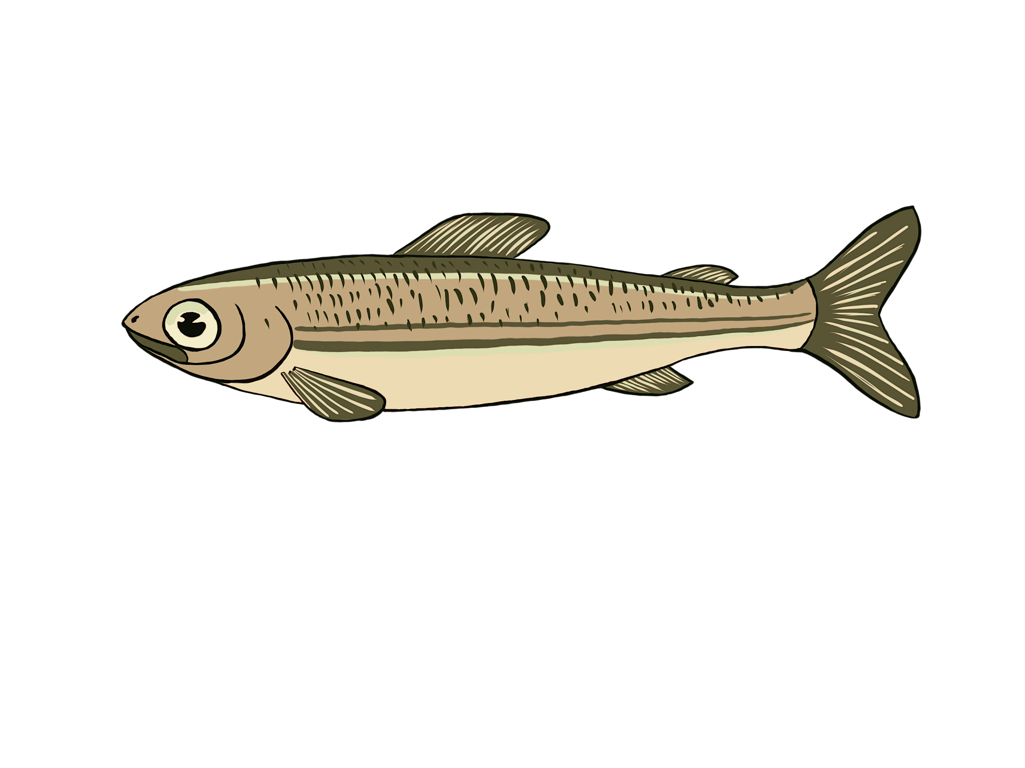
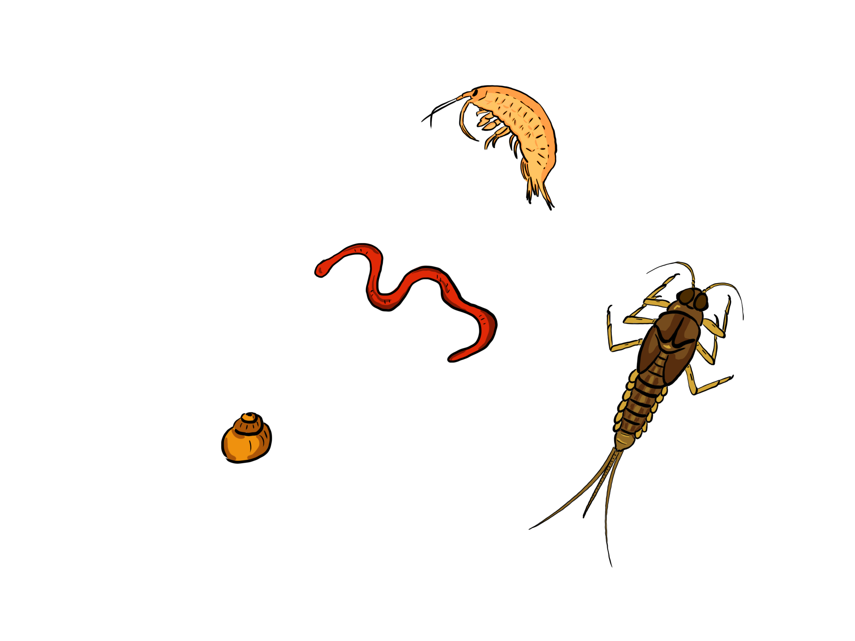
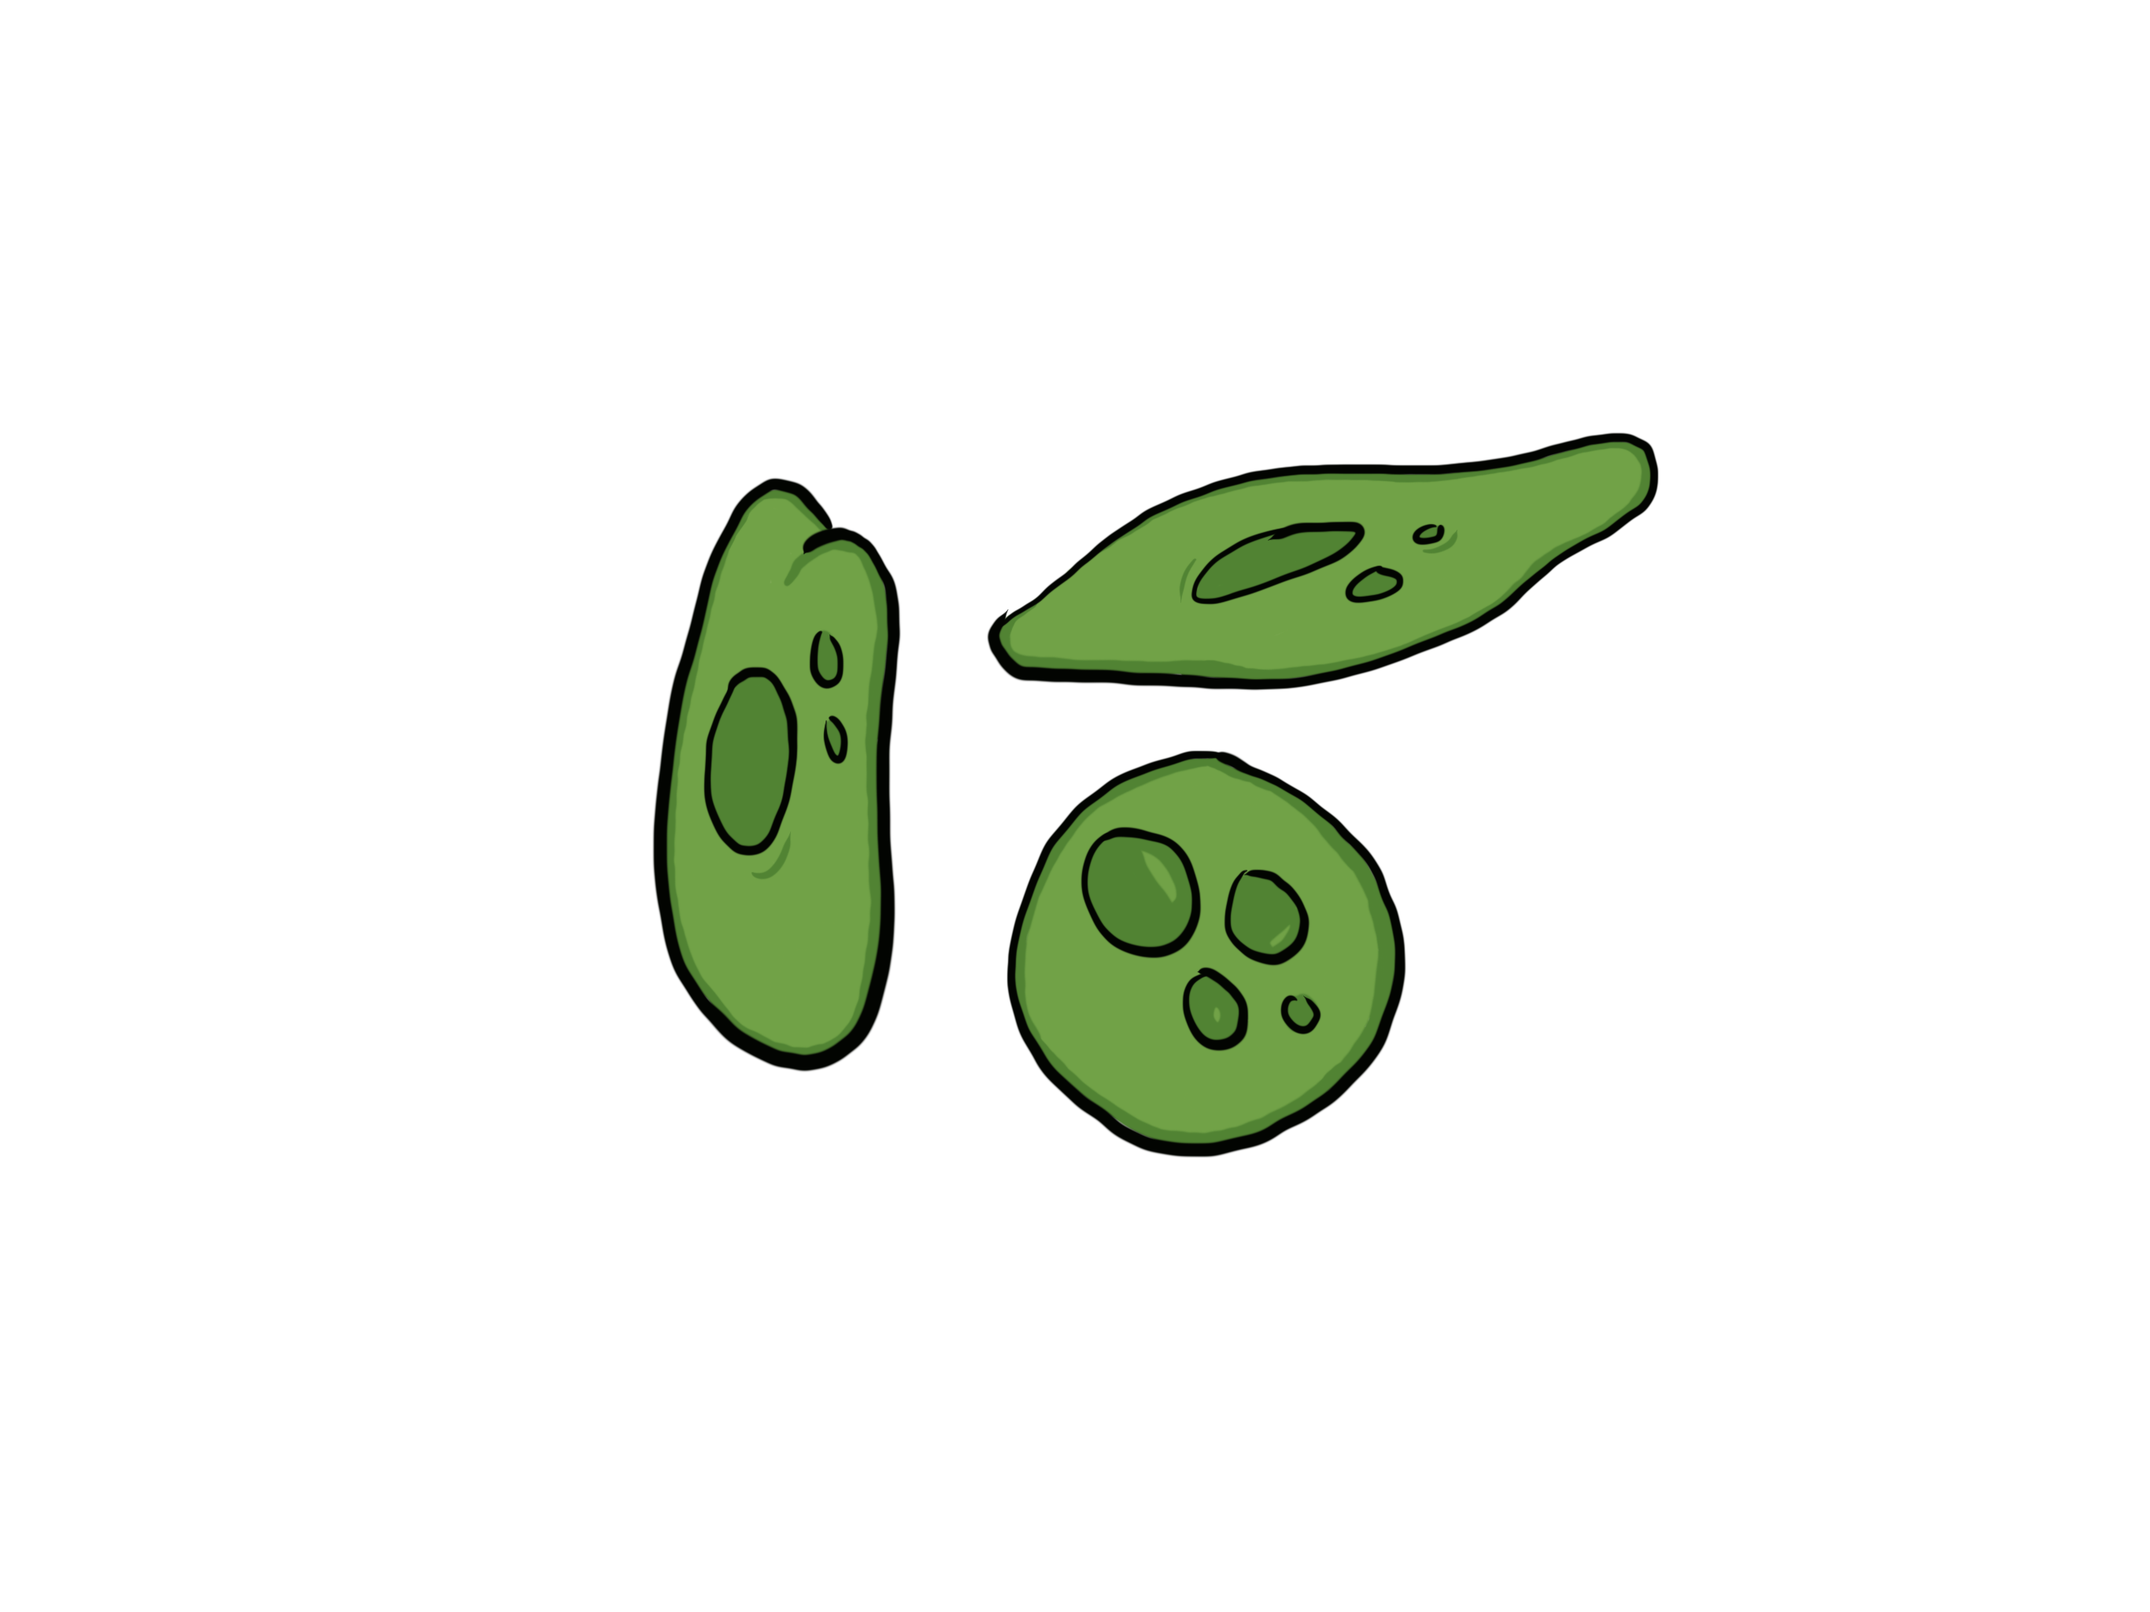

Slide 20
(i) Lake Residency
Proportional Dietary Reliance
(ii) Habitat Coupling
(iii) Creek Residency
Proportional Dietary Reliance
Proportional Dietary Reliance

Slide 21
A
B
C
D
E

Slide 22
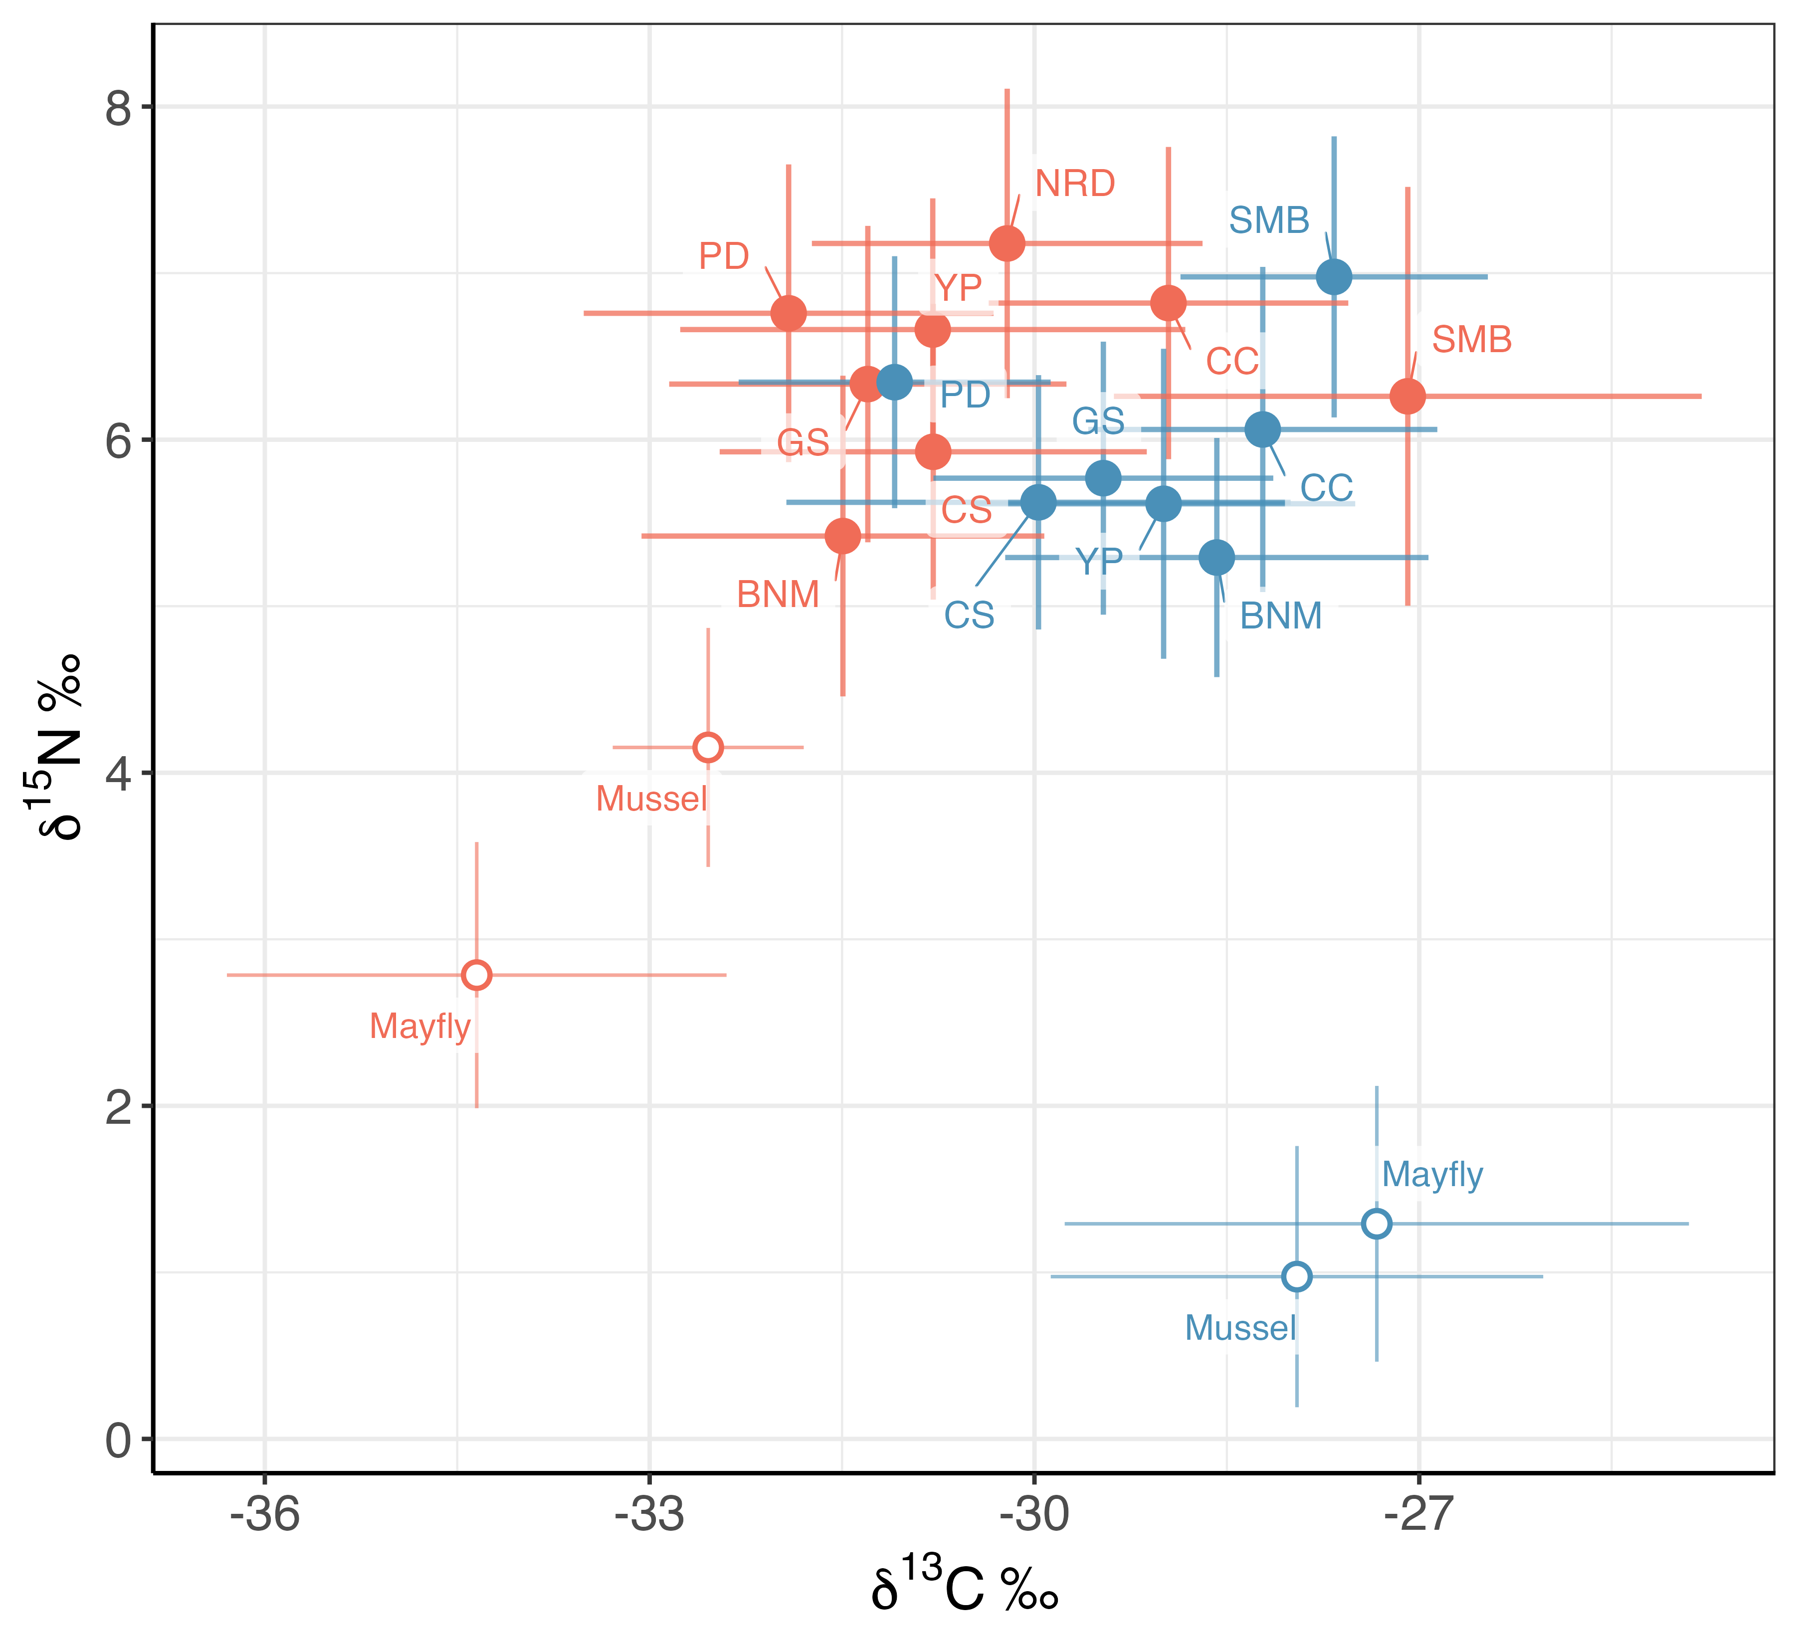
Habitat of capture
Stream
Lake

Slide 23
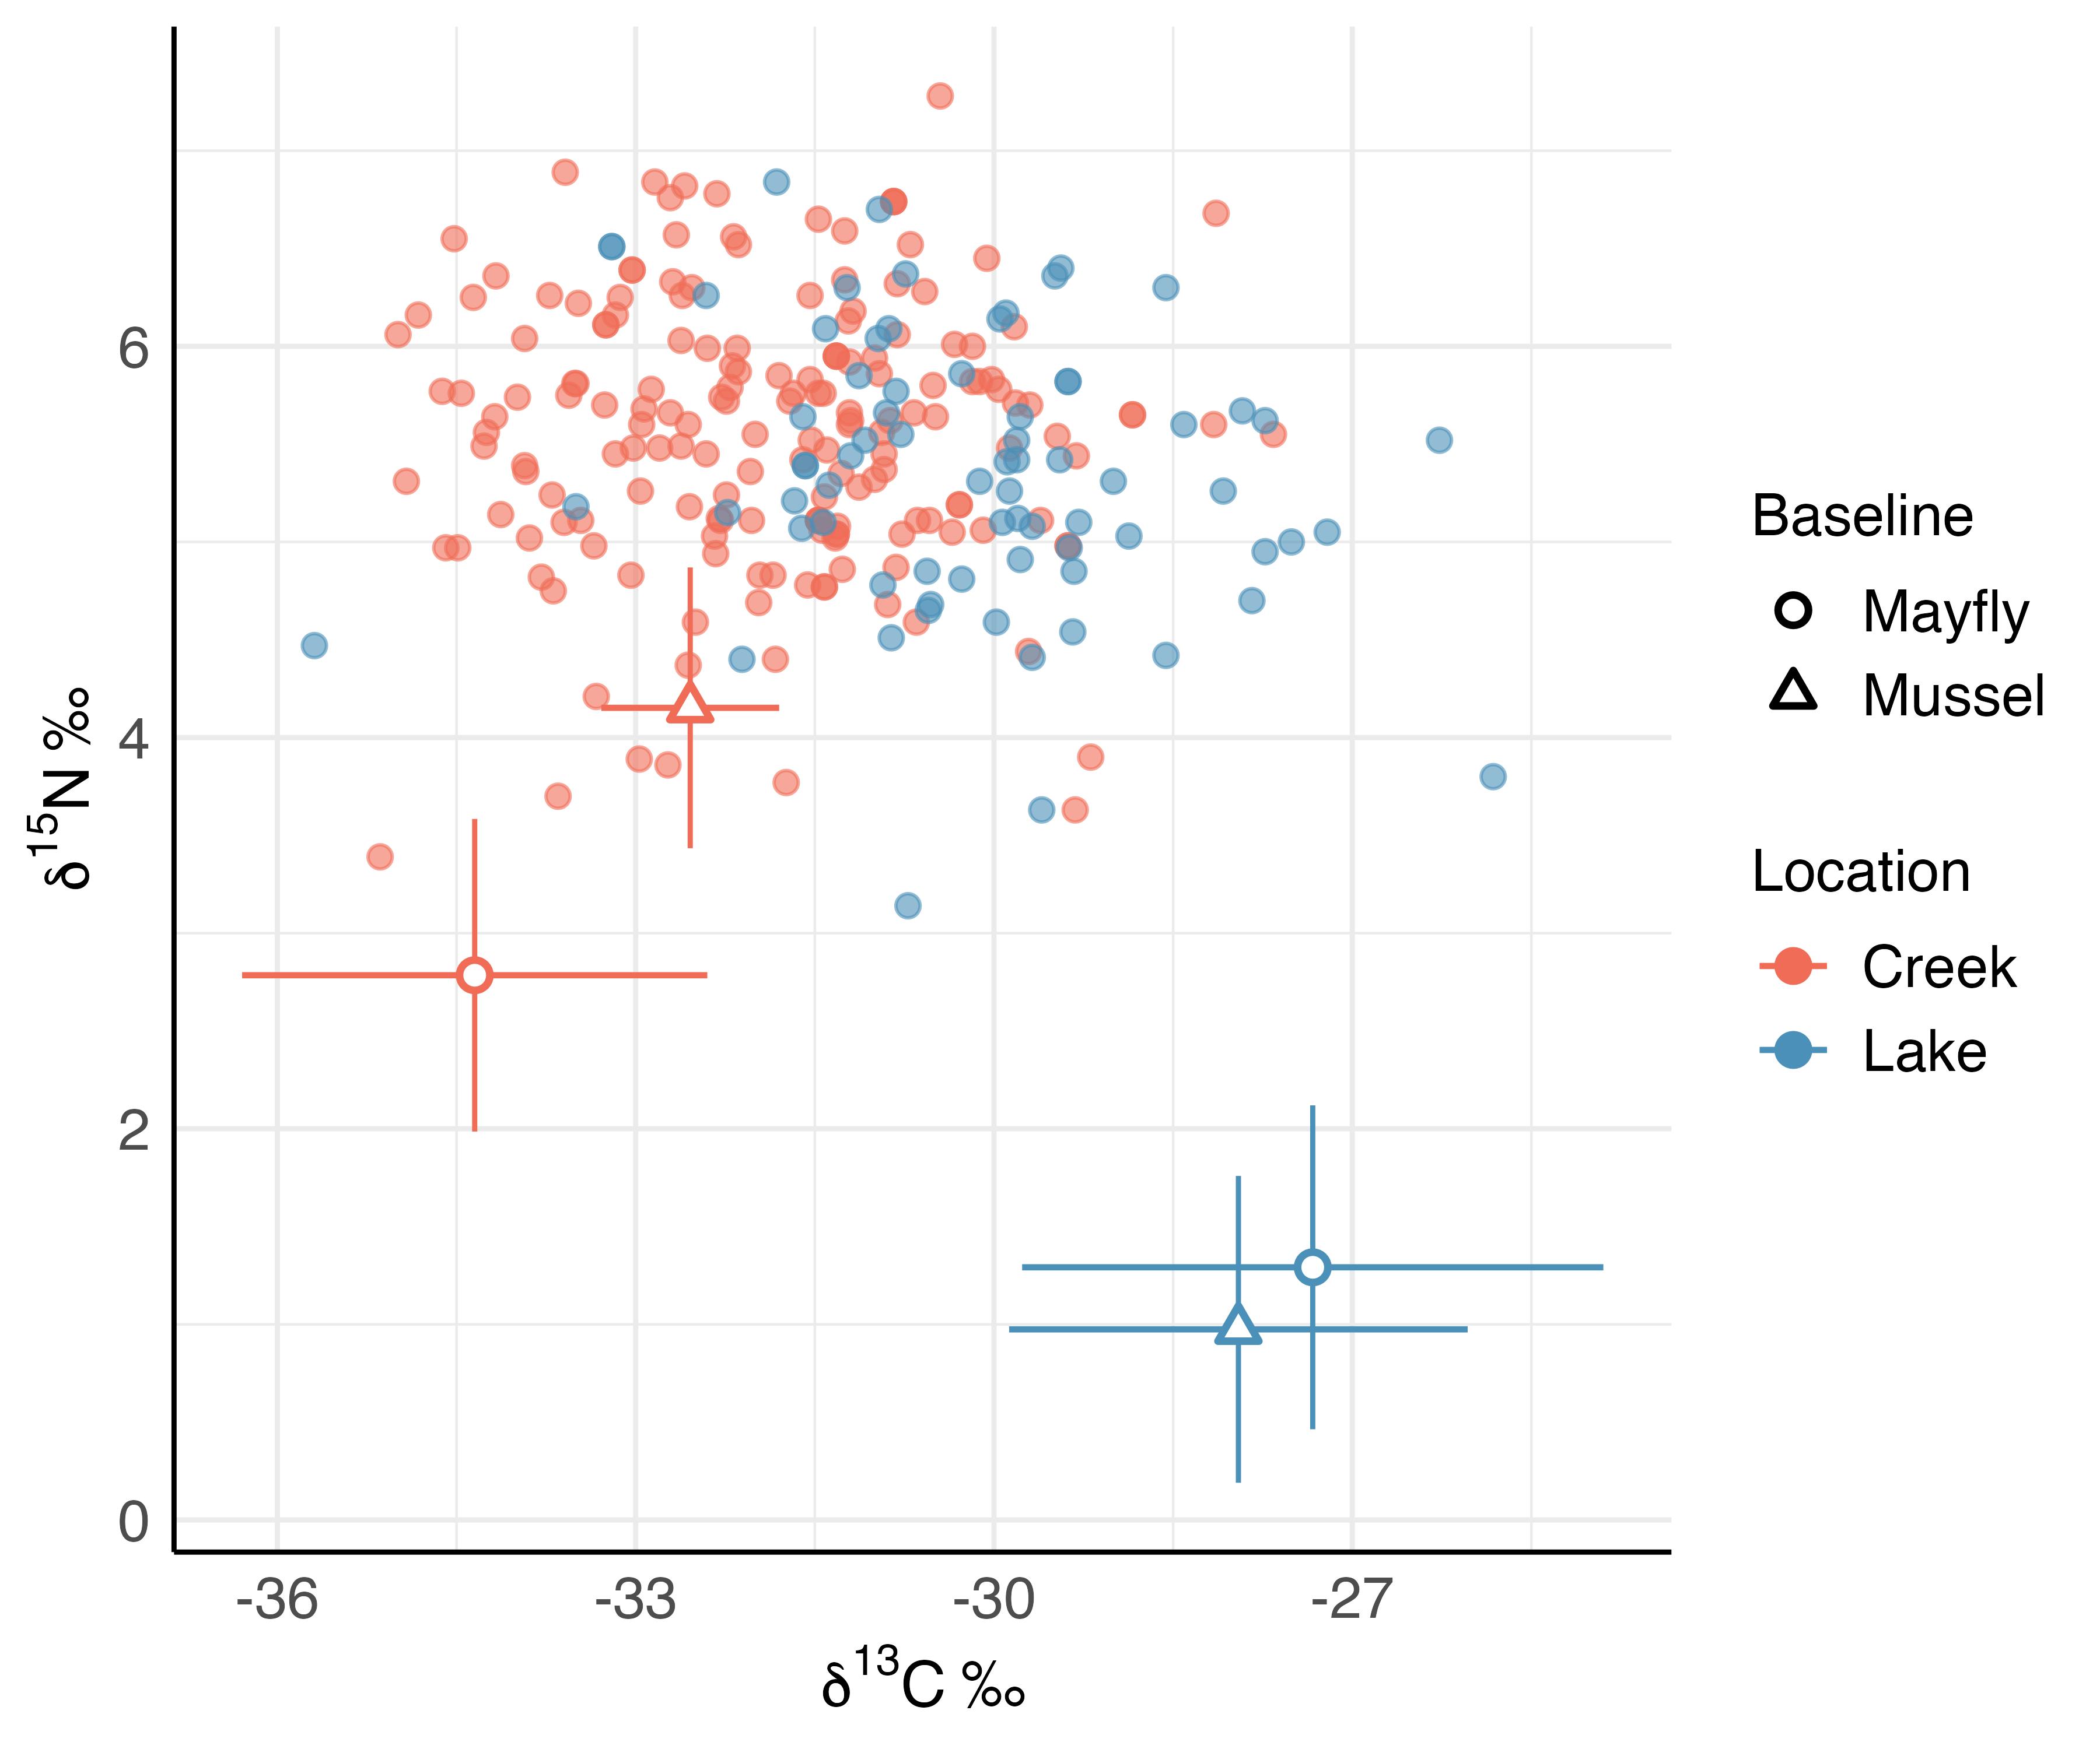
Habitat of capture
Stream
Lake

Slide 24
Location
Stream
Lake
Transition

